Slide 1
Community Health Needs Assessment - 2013
Key Stakeholders Meeting
June 27, 2013
Facilitated by Ruth Bachmeier
Fargo Cass Public Health Director

Slide 2
Ruth Bachmeier, MSN, RN
Fargo Cass Public Health Director

Slide 3
Welcome and Thanks for Being Here!
Greater Fargo Moorhead Community Health Needs Assessment Collaborative was established in May, 2011 in response to the needs of both Public Health and local hospitals to complete Community Health Assessments.
Gathered in May, 2012 to gather your input.
One year later, presentation of findings of our work.

Slide 4
Agenda
Overview of the Health Care Reform & Community Health Needs Assessment
Assessment Results and ND Compass
Key Initiatives
Facilitated Focused Discussion

Slide 5
Carrie McLeod, MBA, MS, RD, LRD, CDE
Corporate Community Benefit/Community Health Improvement
Sanford Health System

Slide 6

Health Care Reform and the Affordable Care Act
The 2010 Health Care Reform enactment requires that each hospital must have conducted a community health needs assessment at least every three years, and take into account input from persons who represent the broad interests of the community served by the hospital facility including those with expertise in public health.

Slide 7

Internal Revenue Code 501 (R) Requirements
Conduct the Community Health Needs Assessment
Collaboration with other
organizations is acceptable
but separate documentation
by facility is required
Adopt an Implementation Strategy
  Adopt a strategy to address each and every need identified in the CHNA
Create Transparency
  CHNA must be made widely available to the public

Slide 8
Essentia and Sanford CHNA Reports
Collaborated on methodology
    Primary Research
      Key stakeholder surveys
      Generalizable surveys
      Internal research for quality and leading diagnosis
      Community Asset Mapping
      Secondary Research
      County Health Profiles
      County Diversity Profiles
      County Aging Profiles
    Implementation Strategies
      Independent by organization
      Collaboration with the Greater Fargo-Moorhead CHNA Collaborative
Notes:
.

Slide 9
Richard Rathge, Ph.D.
Professor – Department of Agribusiness & Applied Economics and Sociology/Anthropology
North Dakota State University

Slide 10
2012 Greater Fargo-Moorhead Community Health Needs Assessment
Survey Results of Residents and Community Leaders
Community Leaders Forum
Fargo, ND
June 27, 2013
Dr. Richard Rathge
Professor
North Dakota State University

Slide 11
Introduction
  Purpose
    To gain insight from residents and key community leaders regarding perceptions of the prevalence of disease and health issues in the F-M metro community
    Collaborative approach to supplying F-M area health providers data for their Needs Assessment
      Leveraged data collection activities for F-M metro health providers

Slide 12
Introduction
  F-M Health Collaborative Members
    Sanford Health
    Essentia Health
    United Way of Cass-Clay
    Dakota Medical Foundation
    North Dakota State University
    Fargo Cass Public Health
    Clay County Public Health
    Family HealthCare Center
    Urban Indian Health and Wellness of Center of Fargo-Moorhead
    Center for Rural Health at UND
    Southeast Human Services Center

Slide 13
Study Design and Methodology
Two Independent Surveys: Resident and Community Leaders
  Developed in collaboration with F-M Community Health Needs Assessment Collaborative
  Major themes addressed:
    1. Community assets
    2. General concerns about communities
    3. A variety of community health and wellness concerns
    4. Personal health care information
  Approved by the Institutional Review Board at NDSU
Methodology
  Residents: Mail survey to 1,500 randomly selected households in F/M area
    236 completed surveys returned for a response rate of 17%
    Generalizable sample; confidence level of 95% with an error rate of +/- 6%
  Community Leaders: (elected, nonprofit, health professionals, social workers, educators)
    Conducted at public meeting with follow-up contacts via email
    58 surveys completed --not generalizable of all community leaders

Slide 14
Survey Results
Community Assets:
Best Things About Our Community Regarding:
People (7)
Services and Resources (6)
Quality of Life (6)

Slide 15
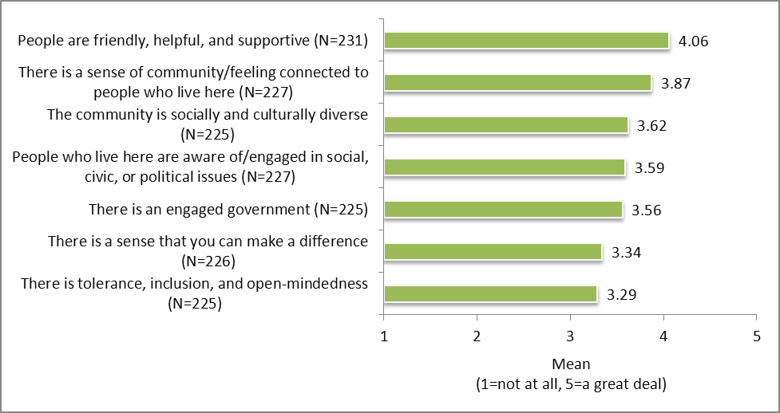
Residents’ level of agreement with statements about their community regarding PEOPLE
Residents agreed most that:
  People in their community are friendly, helpful, and supportive
  There is a sense of community or feeling connected to people who live here
Residents agreed least that:
  There is tolerance, inclusion, and open-mindedness (although still a moderate level of agreement)

Slide 16
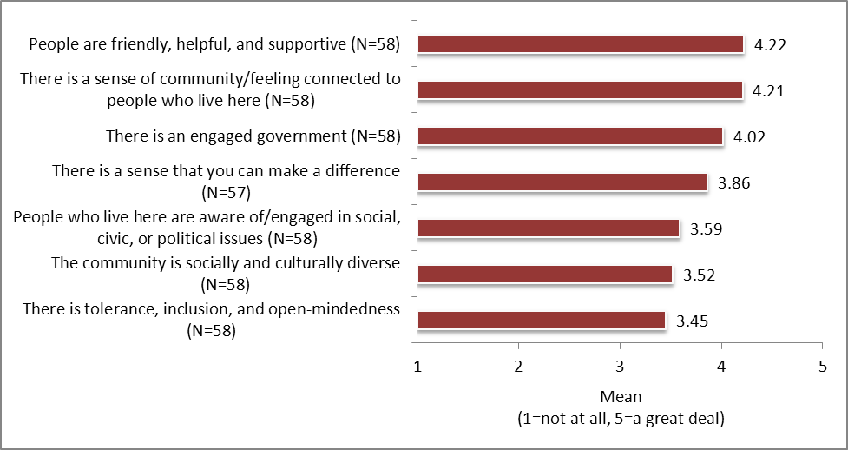
Community Leaders’ level of agreement with statements about their community regarding PEOPLE
Leaders agreed most that:
  People in their community are friendly, helpful, and supportive
  There is a sense of community or feeling connected to people who live here
Leaders agreed least that:
  There is tolerance, inclusion, and open-mindedness (although still a moderate level of agreement)
Leaders had slightly higher levels of agreement
than residents

Slide 17
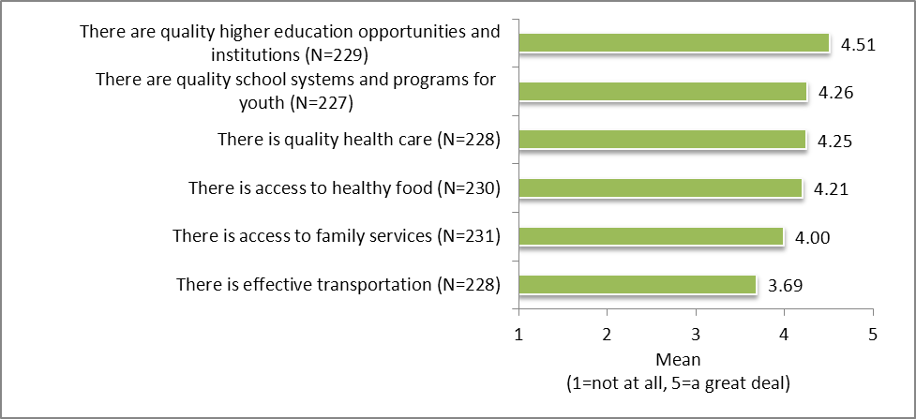
Residents’ level of agreement with statements about their community regarding SERVICES AND RESOURCES
Residents agreed most that:
  There are quality higher education opportunities and institutions
  There are quality school systems and programs for youth
  There is quality health care
Residents agreed the least that:
  There is effective transportation (although still moderately high level of agreement)

Slide 18
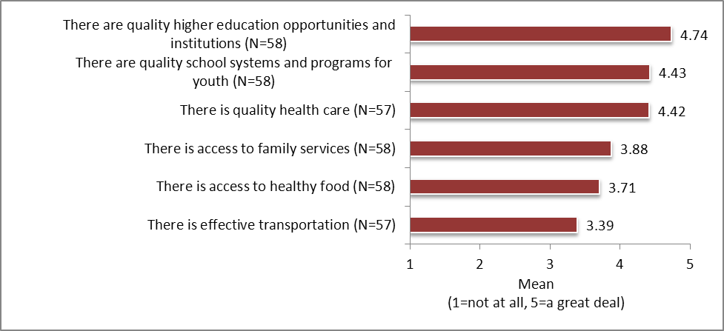
Respondents’ level of agreement with statements about their community regarding SERVICES AND RESOURCES
Leaders agreed most that:
  There are quality higher education opportunities and institutions
  There are quality school systems and programs for youth
  There is quality health care
Leaders agreed the least that:
  There is effective transportation (although still moderately high level of agreement)
Leaders had slightly higher levels of agreement
than residents

Slide 19
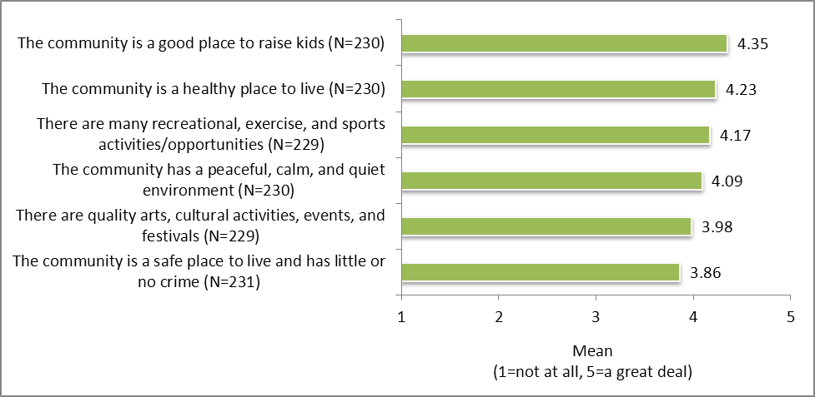
Residents’ level of agreement with statements about their community regarding QUALITY OF LIFE
Residents agreed most that:
  Their community is a good place to raise kids
  Their community is a healthy place to live
Residents agreed least that:
Their community is a safe place to live and has little or no crime (although still a moderately high level of agreement)

Slide 20
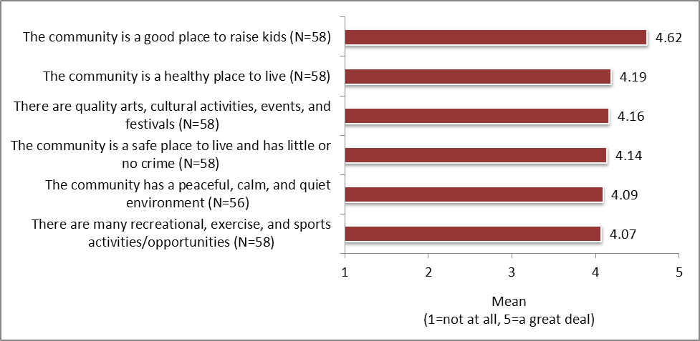
Respondents’ level of agreement with statements about their community regarding QUALITY OF LIFE
Leaders agreed most that
  Community is a good place to raise kids
  High level of agreement with remaining
Leaders had distinctly higher levels of agreement
than residents

Slide 21
Survey Results
2. General Community Concerns regarding
Economic Issues (8)
Transportation (6)
Environment (4)
Children and Youth (7)
Aging Population (5)
Safety (6)
Total of 36 indicators

Slide 22

Key Findings
Concerns about:
The aging population
  Mean: Residents Leaders
Availability/cost of long-term care 3.66 3.91
Availability of resources to help elderly stay in their homes 3.56 3.89
Availability of resources for family/friends caring for elders 3.53 3.86

Slide 23
Key Findings
Concerns about:
Safety issues
  Mean: Residents Leaders
  Presence and influence of drug dealers 3.51 3.57
  Domestic violence 3.46 3.97*
  Property crimes 3.41 3.14
  Child abuse and neglect 3.39 3.76*
Elder abuse 3.08 3.25
  Violent crimes 3.06 3.09

Slide 24

Key Findings
Concerns about:
Economic issues
  Mean: Residents Leaders
  Availability of employment opportunities 3.49 3.69
  Economic disparities between higher & lower classes 3.44 3.64
  Cost of living 3.43 3.16
  Wage levels 3.35 3.43
Availability of affordable housing 3.31 3.47
  Poverty 3.20 3.62*
Homelessness 3.01 3.64*

Slide 25

Key Findings
Concerns about:
Children and youth
  Mean: Residents Leaders
  Bullying 3.44 3.82
  Availability and/or cost of quality child care 3.42 3.91*
  Availability and/or cost of activities for children & youth 3.27 3.67
  Availability and/or cost of services for at-risk youth 3.05 3.81*
Youth crime 3.04 3.09
  Teen pregnancy 2.93 3.34
School dropout rates/truancy 2.82 3.56*

Slide 26
Survey Results
3. Health and Wellness Concerns
19 indicators regarding access to health care
10 indicators regarding physical and mental health
4 indicators regarding substance use and abuse

Slide 27

Key Findings
Concerns about:
Health and Wellness
5 Top Concerns
  Mean: Residents Leaders
  The cost of health insurance 4.32 4.57
  The cost of health care 4.25 4.48
  The cost of prescription drugs 4.06 4.34
  The adequacy of health insurance coverage 3.97 4.24
  Access to health insurance coverage 3.79 4.16

Slide 28

Survey Results: Personal Health Care Information

Slide 29
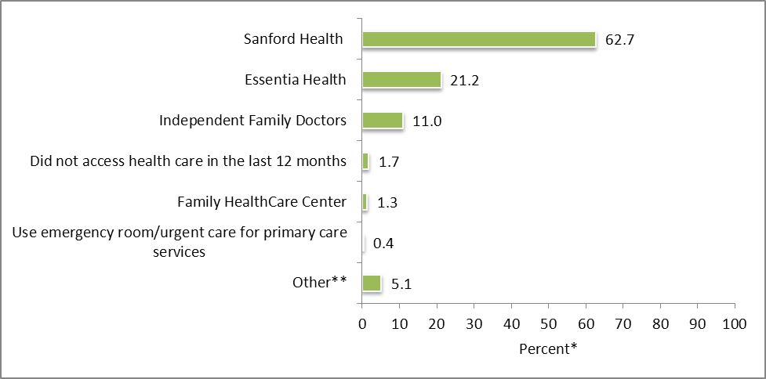
Residents’ primary health care provider
3 in 5 respondents use Sanford Health
1 in 5 respondents use Essentia Health
N=236
*Percentages do not equal 100.0 due to multiple responses.

Slide 30
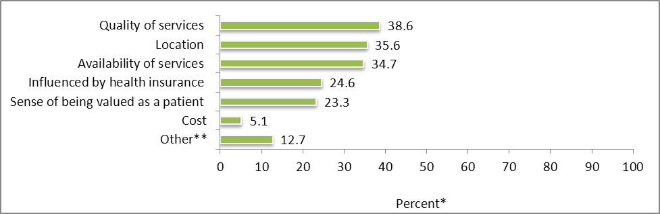
Residents’ reasons for choosing primary health care provider
Top 3 reasons:
  Quality of services
  Location
  Availability of services
Cost is not an issue for most respondents
N=236
*Percentages do not equal 100.0 due to multiple responses.

Slide 31
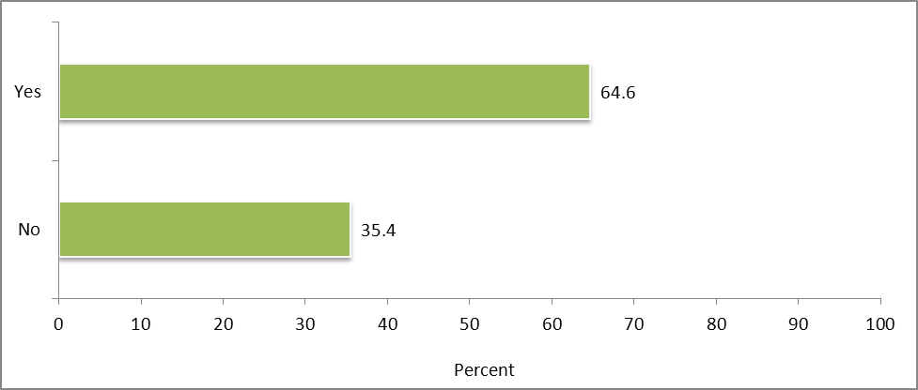
Whether residents had a cancer screening or cancer care in the past year
1 in 3 respondents had not had a cancer screening or cancer care in the past year
N=223

Slide 32
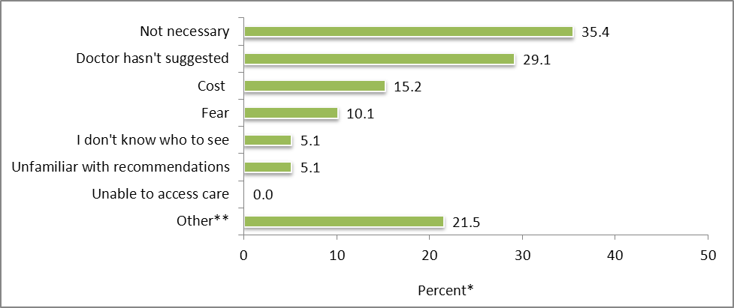
Among residents who have not had a cancer screening or cancer care in the past year, reasons for not having done so
35.4% said it was not necessary
29.1% said doctor had not suggested it
15.2% said cost
10.1% said fear
Other reasons
  Not due to have a screening (5)
  Have chosen not to screen (3)
N=79
*Percentages do not equal 100.0 due to multiple responses.

Slide 33
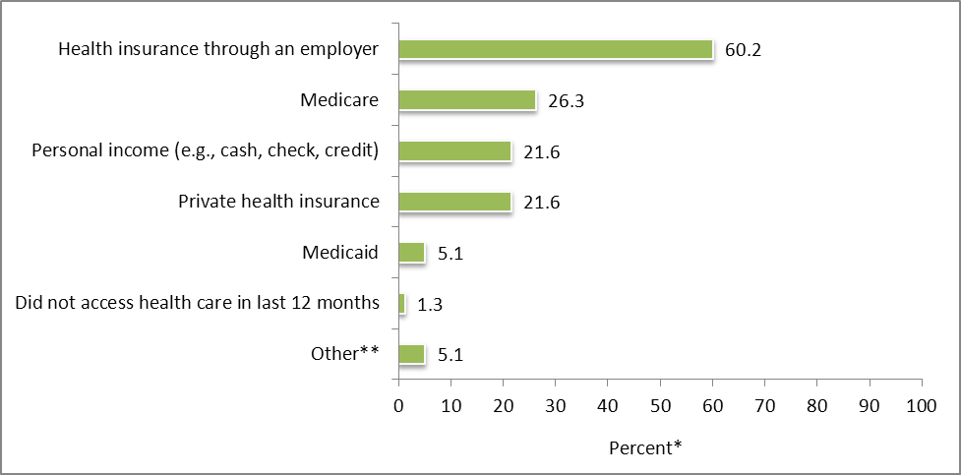
Methods residents have used to pay for health care costs over the last 12 months
Majority of respondents paid with health insurance through an employer
26.3% used Medicare
26.1% used personal income
26.1% used private health insurance
N=236
*Percentages do not equal 100.0 percent due to multiple responses.

Slide 34
Demographic information
Survey Results

Slide 35
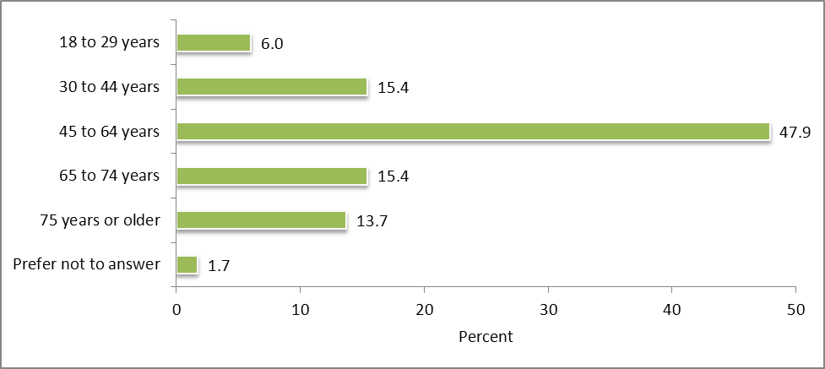
Residents’ age
Majority were
45 to 64 years
29.1% were
65 years or older
Sample under-represented 18-29 age group and over-represented senior age group
when compared to Census data.

Slide 36
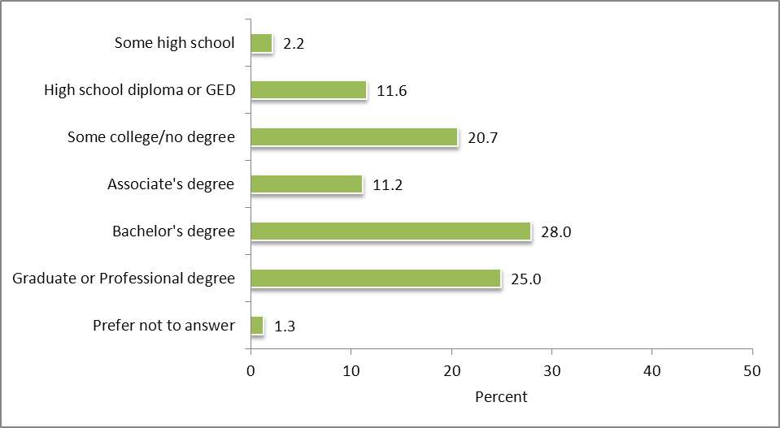
Residents’ highest level of education
N=232
Majority had Bachelor’s degree or higher
  Includes 25% who had a Graduate or Professional degree
1 in 10 had, at most, a high school diploma or GED
Sample under-represented those with High School degree or less and over-
represented those with a graduate or professional degree compared to Census

Slide 37
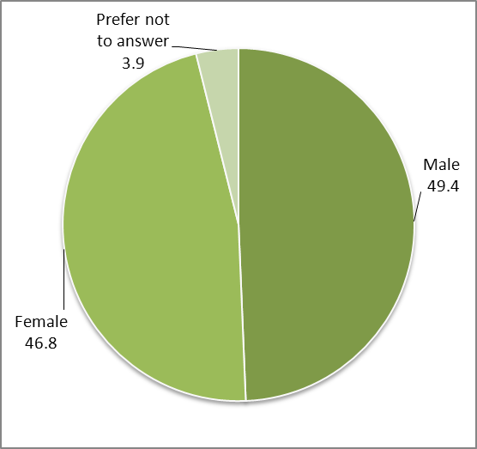
Residents’ gender
Evenly split between males and females

Slide 38
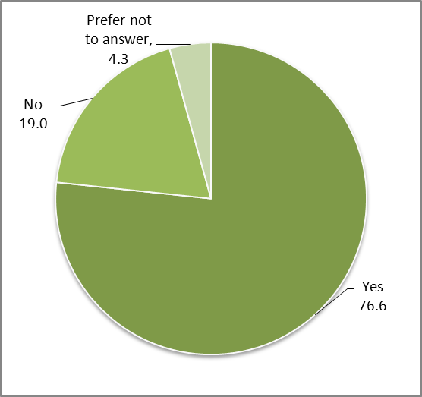
Whether residents work/volunteer outside the home
3 in 4 respondents said they work or volunteer outside their home

Slide 39
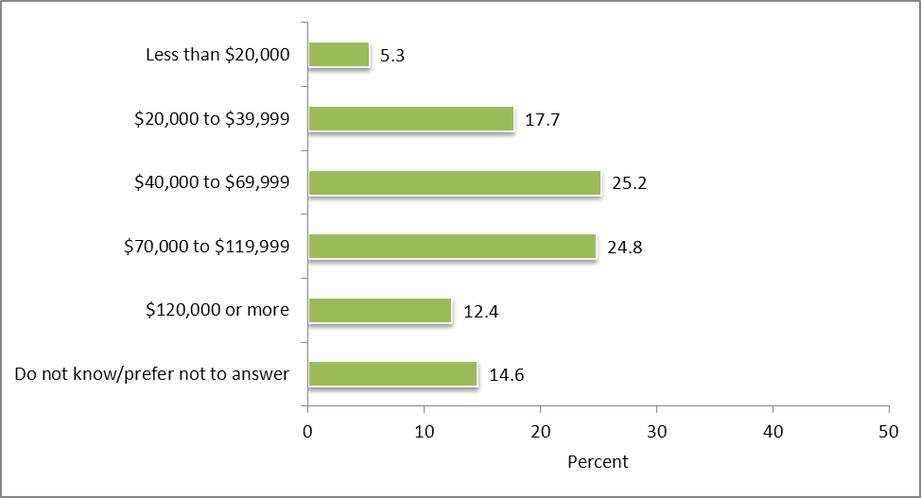
Residents’ annual household income before taxes
N=226
25% had an annual household income of $40,000 to $69,999
25% had an annual household income of $70,000 to $119,999
5% earned less than $20,000 annually
Sample under-represented those with income less than $20,000 and over-
represented those with incomes over $120,000 compared to Census data.

Slide 40
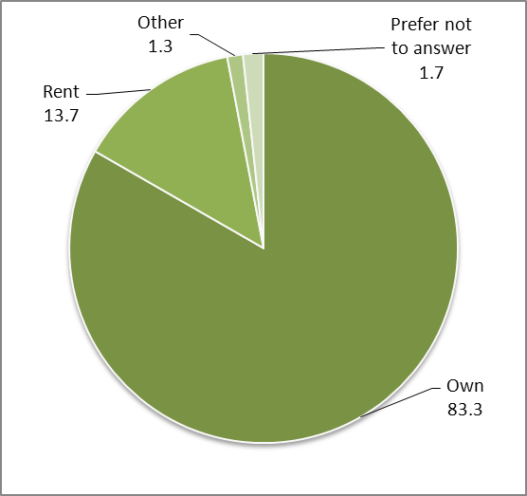
Whether residents own or rent their home
Vast majority own their home
Sample under-represented renters
and over-represented owners
compared to Census data

Slide 41
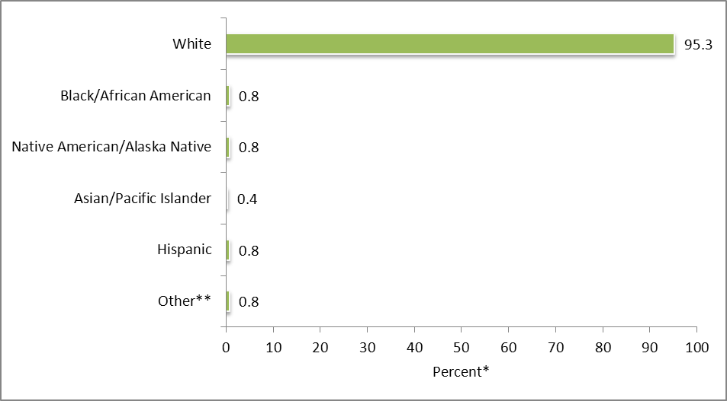
Residents’ race or ethnicity
N=236
*Percentages do not equal 100.0 due to multiple responses.
Vast majority white
Other**
  Euro-American (1)
  Native-born American of German royalty (1)

Slide 42
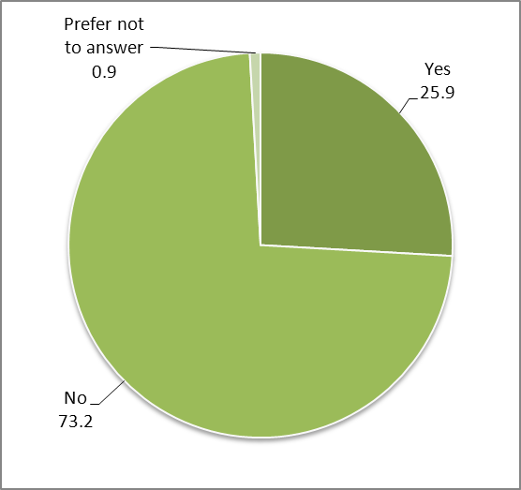
Whether residents are the parent or primary caregiver of a child or children 18 years of age or younger
1 in 4 respondents are the parent or primary caregiver of a child or children 18 years of age or younger

Slide 43
Take Away Points
Health Collaborative Successful Model
  Brought area health providers together for common goal
  Successful leveraging of resources
    Expenses to conduct needs assessment
    Reduce respondent burden
Community Leaders Mirror Residents’ Views
  Leaders shared views and priorities of residents
Results are Available for Community Use
  ND Compass a platform for sharing community data

Slide 44
Donald Warne, MD, MPH
Director, Master of Public Health Program
North Dakota State University
F-M American Indian Community-Sponsored Health Needs Assessment

Slide 45
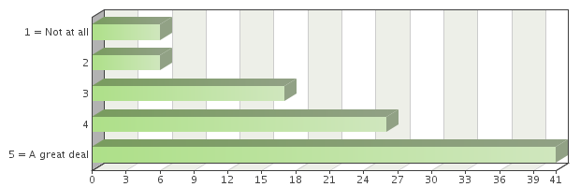
Cost of Health Care

Slide 46
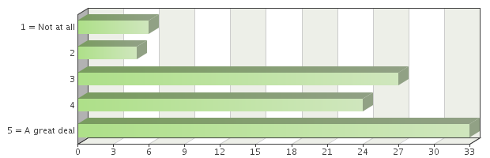
Cost of Prescription Drugs

Slide 47
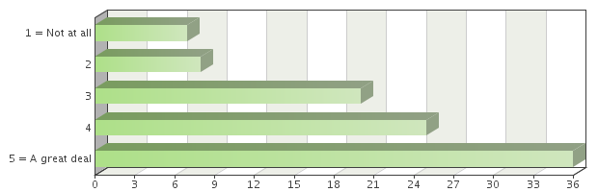
Cost of Health Insurance

Slide 48
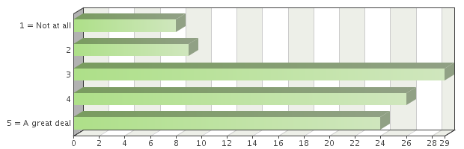
Availability of Prevention Programs or Services

Slide 49
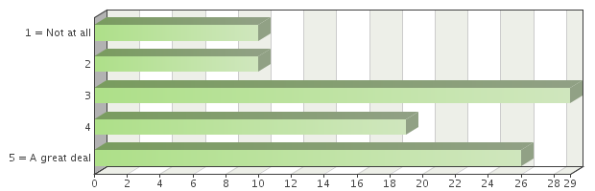
Distance to Health Care Services

Slide 50
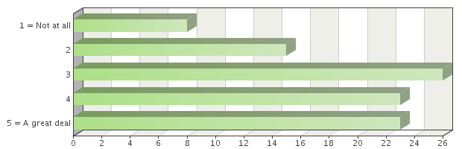
Availability of/Access to Transportation

Slide 51
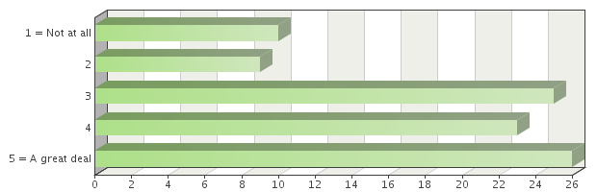
Time it takes to get an Appointment

Slide 52
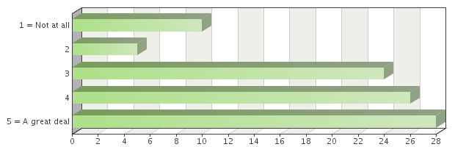
Use of Emergency Room Services for Primary Care

Slide 53
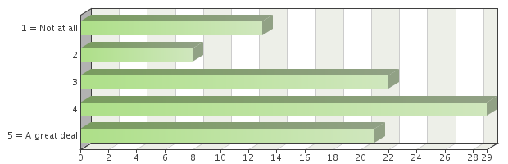
Availability of Mental Health Services and Providers

Slide 54
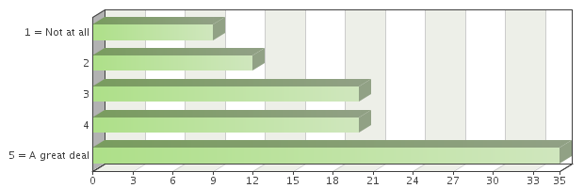
Levels of Obesity

Slide 55
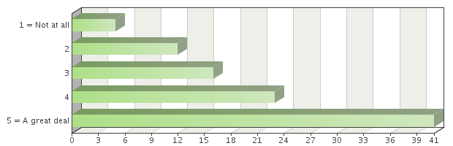
Poor Nutrition/Eating Habits

Slide 56
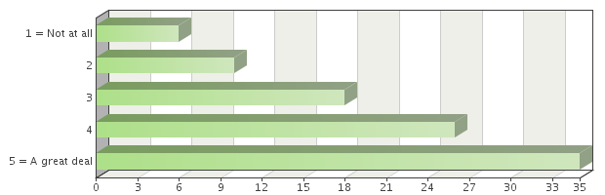
Inactivity and/or Lack of Exercise

Slide 57
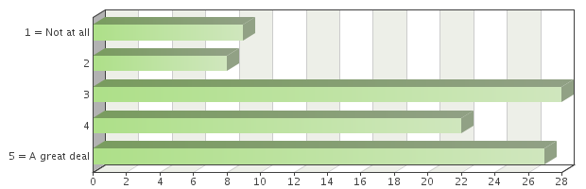
Cancer

Slide 58
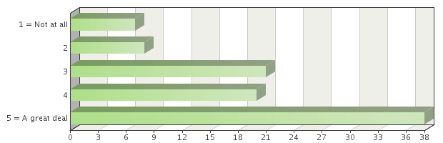
Chronic Disease (e.g. diabetes, heart)

Slide 59
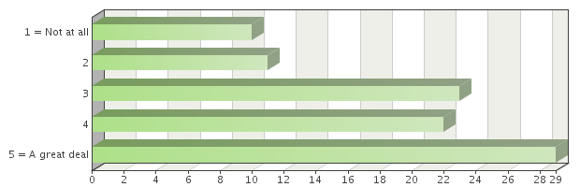
Communicable Diseases (e.g. STDs, AIDS)

Slide 60
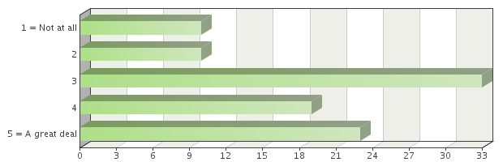
Dementia/Alzheimer’s Disease

Slide 61
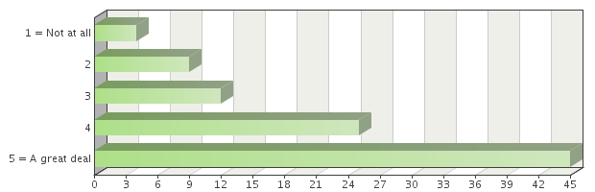
Levels of Depression

Slide 62
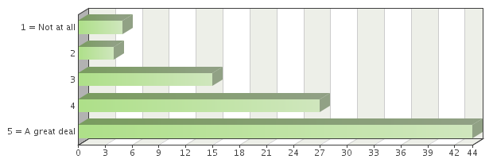
Stress

Slide 63
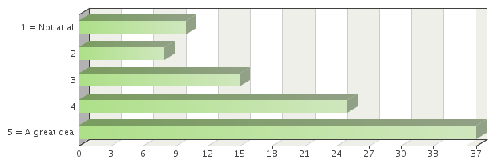
Suicide

Slide 64
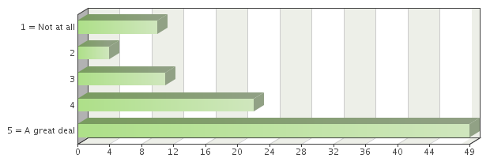
Alcohol Use and Abuse

Slide 65
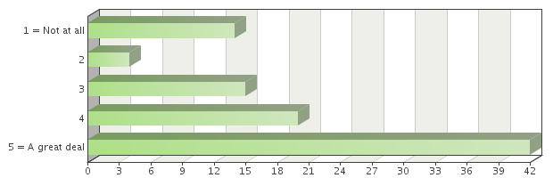
Drug Use and Abuse

Slide 66
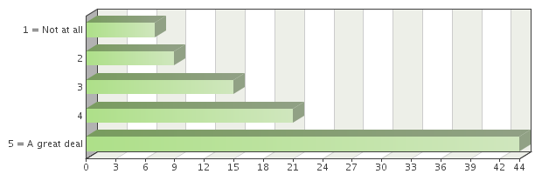
Smoking and Tobacco Use

Slide 67
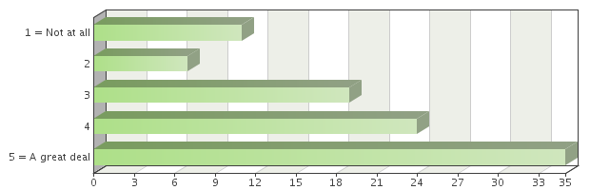
Exposure to Secondhand Smoke

Slide 68
Ramona Danielson, MS
Center for Social Research
Research Analyst
Assistant Director for the ND Compass project
North Dakota State University

Slide 69
Community input and data identified three primary issues
Obesity
  Poor nutrition, inadequate physical activity, availability of preventive services, coordination of care
  Mental Health
    Depression, suicide, stress, alcohol use and abuse, prescription medication abuse, availability of MH services, coordination of care
  Elder Care
    Availability of resources, coordination of care, elder abuse, prevention programs

Slide 70
Kim Lipetzky, MNS, RD, LRD
Public Health Nutritionist
Fargo - Cass Public HEalth

Slide 71
Obesity Initiative
CassClayalive! (Cass Clay Healthy People Initiative)
  *Schoolsalive! *Childcarealive!
  *Streetsalive! *Faithcommunitiesalive!
  *Join the Movement
Cass Clay Food Systems Initiative
PartnerSHIP 4 Health
North Dakota Worksite Wellness Initiative
Active in Moorhead (AIM)
Go 2030 Fargo Comprehensive Plan
Let’s Move! Cities, Towns and Counties
Health care institution plans and activities

Slide 72
Gina Nolte, MS, BSN
PartnerSHIP4 Health Director
Clay County Public Health
Leah Deyo – MPH student

Slide 73

Mental Health Initiative
Mental Health is a Community Issue
Communities prosper when mental health needs are met.
Mental health issues negatively influence:
        Homelessness
        Poverty
        Employment
        Safety
        Local Economy

Slide 74
1 in 4 adults, 1 in 5 children with mental illness
= 40,000 adults and 11,000 children in Cass and Clay Counties.
Facts and Figures 2008 - Section 5 Table of Contents. Healthcare Cost and Utilization Project (HCUP). October 2010.
Agency for Healthcare Research and Quality, Rockville, MD. www.hcup-us.ahrq.gov/reports/factsandfigures/2008/section5_TOC.jsp

Slide 75
Did you know?
Mental illness is leading cause of disability in U.S.
Many people can recover completely from mental illness
Barriers prevent people from seeing mental health specialists
  Still seeing primary care providers
  Sanford collaborative care model
  Cost benefits and social benefits
Mental illness and substance abuse are commonly co-occurring
Inmates, homeless populations vulnerable to mental illness

Slide 76
Mental Health Among Youth
Approx. 50% of students (14 and older) with mental illness drop out of school
50% of adult mental health problems begin before age 14
75% of adult mental health problems begin before age 24
Schools play a critical role in identifying problems
  Unequipped to address mental health issues

Slide 77
Group Discussion
Mental Health – Obesity – Services for the Elderly
  What is happening to address this issue?
  Who is doing the work?
  What areas within this need are being addressed?
  What other areas still need to be addressed?

Slide 78
Kathy McKay, BSN
Clay County Public Health Director

Slide 79
Final Remarks
Thank you for your input and ideas today
If you have an interest in serving on one of the initiatives – please join us.

